Slide 1
Emergent dynamics and learning in the neocortex
Randall C. O’Reilly
UC Davis, eCortex, Astera Obelisk Lab

Slide 2
Emergence
* Material independent
* All about the interactions / relationships
* Condensed matter, e.g., spin glass: spatially-defined interactions
* Brain: network-defined interactions (with spatial biases)
* Each neuron interacts with ~10,000 others: highly emergent!

Slide 3
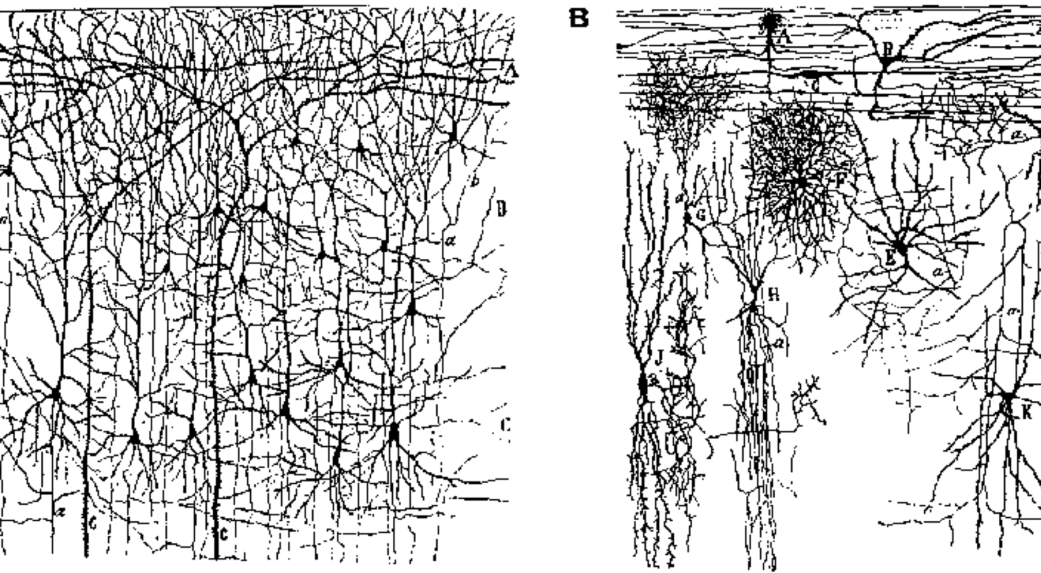
Neurons: Excitatory and Inhibitory
Excitatory = main info processing, long-range connections
Inhibitory = local, activity regulation and competition

Slide 4
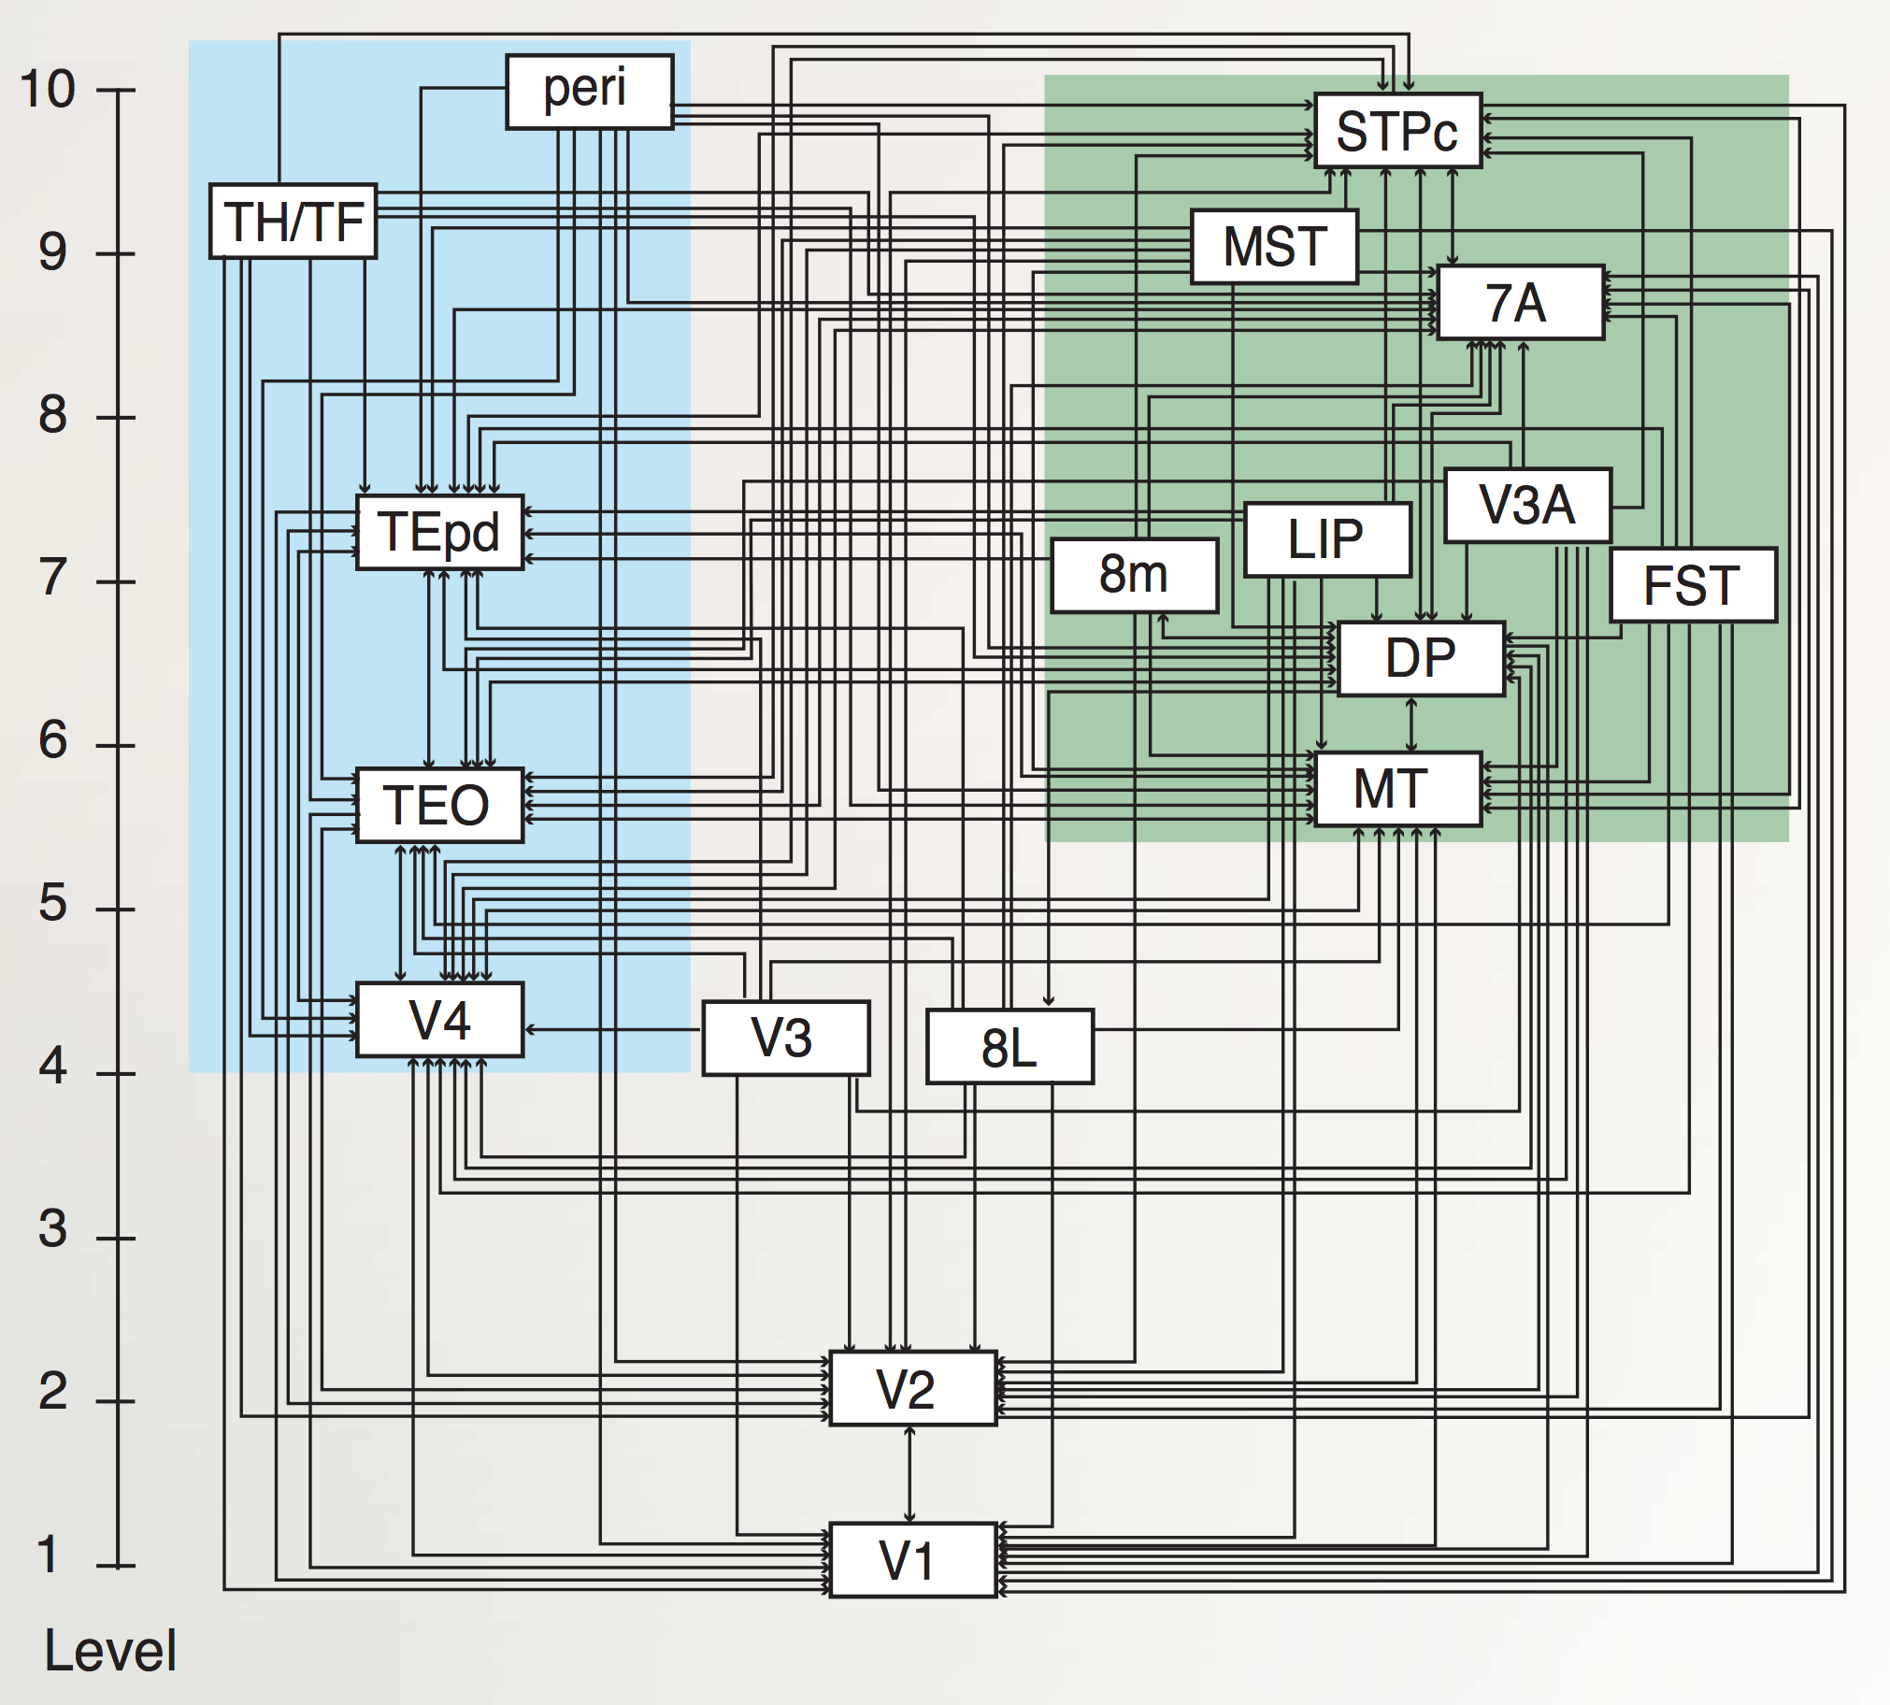
“Van Essen” Hierarchy
TE.. = Temporal
LIP, DP.. = Parietal
8L = Frontal Eye Field
To hippocampus:
TH/F = Parahippo
peri = Perirhinal
Markov et al., 2014

Slide 5
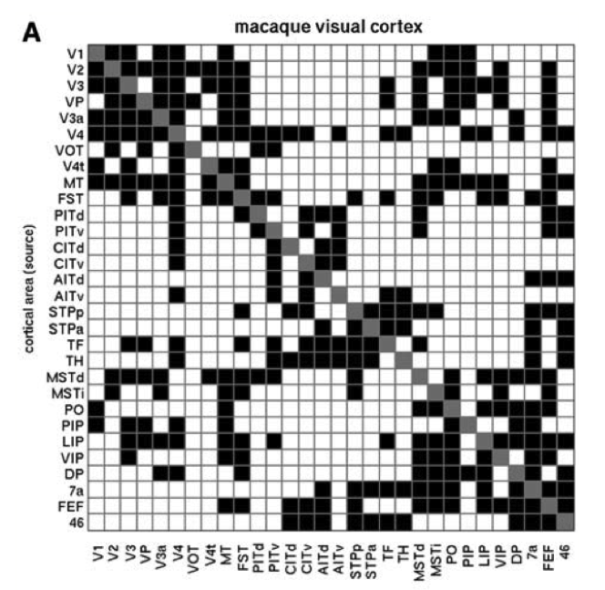
Bidirectional Symmetry

Slide 6
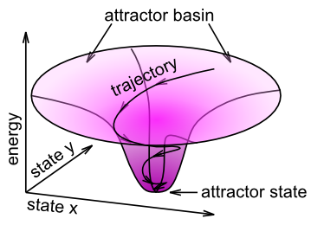
Bidirectional Excitatory Dynamics

Slide 7
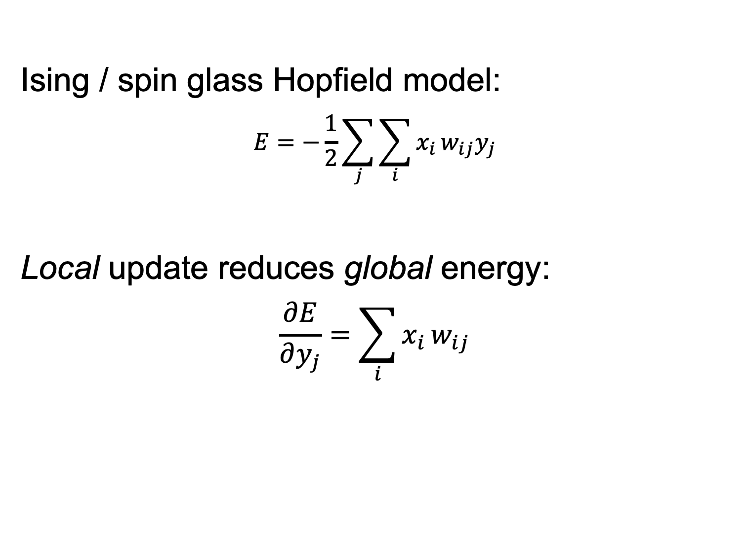
Multiple constraint satisfaction
Ising / spin glass Hopfield model:
$$E=−\frac{1}{2}\sum_{j}^{​}{\sum_{i}^{​}{x_{i}}}w_{ij}y_{j}$$
Local update reduces global energy:
$$\frac{∂E}{∂y_{j}}=\sum_{i}^{​}{x_{i}}w_{ij}$$

Slide 8
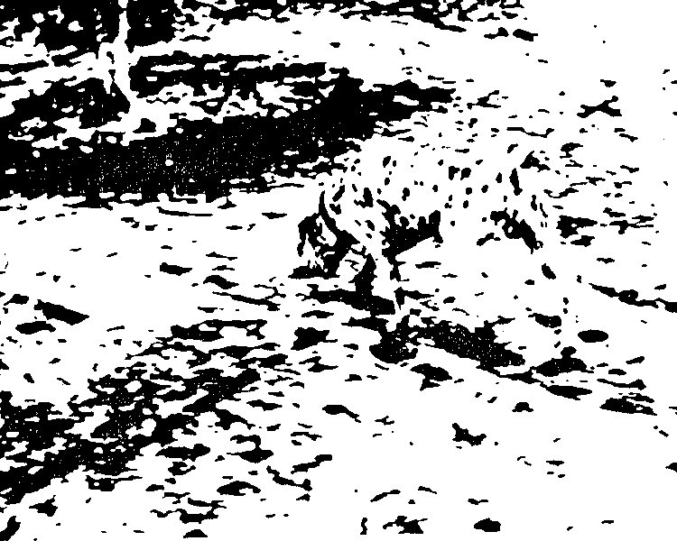
Top-down Ambiguity Resolution

Slide 9
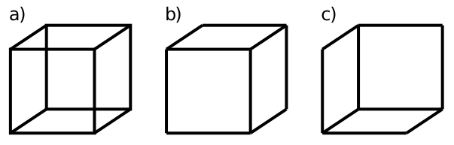
Behold, the cube!

Slide 10
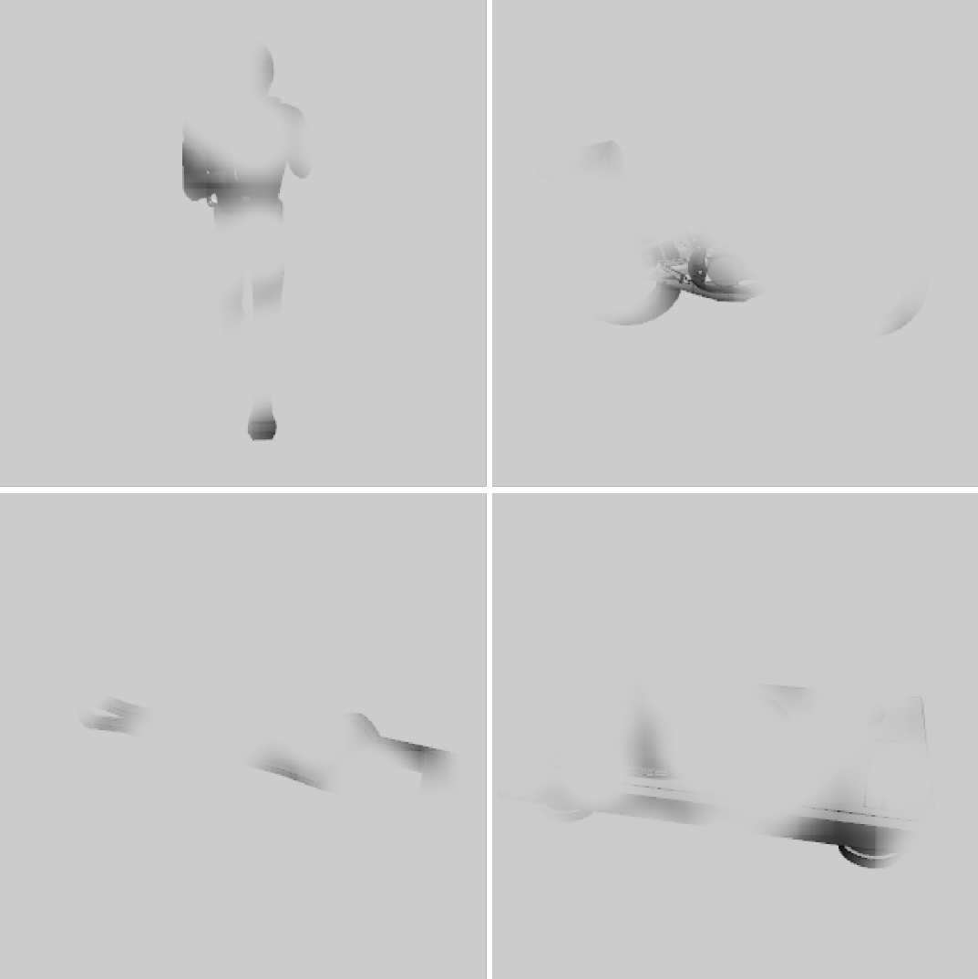
What Are These?

Slide 11
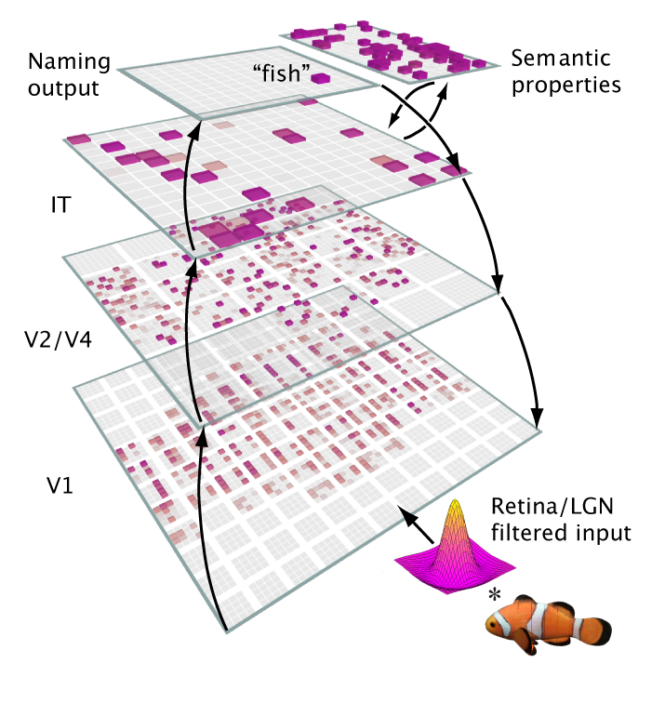
A Big Network Model..

Slide 12

Bidirectional Dynamics

Slide 13
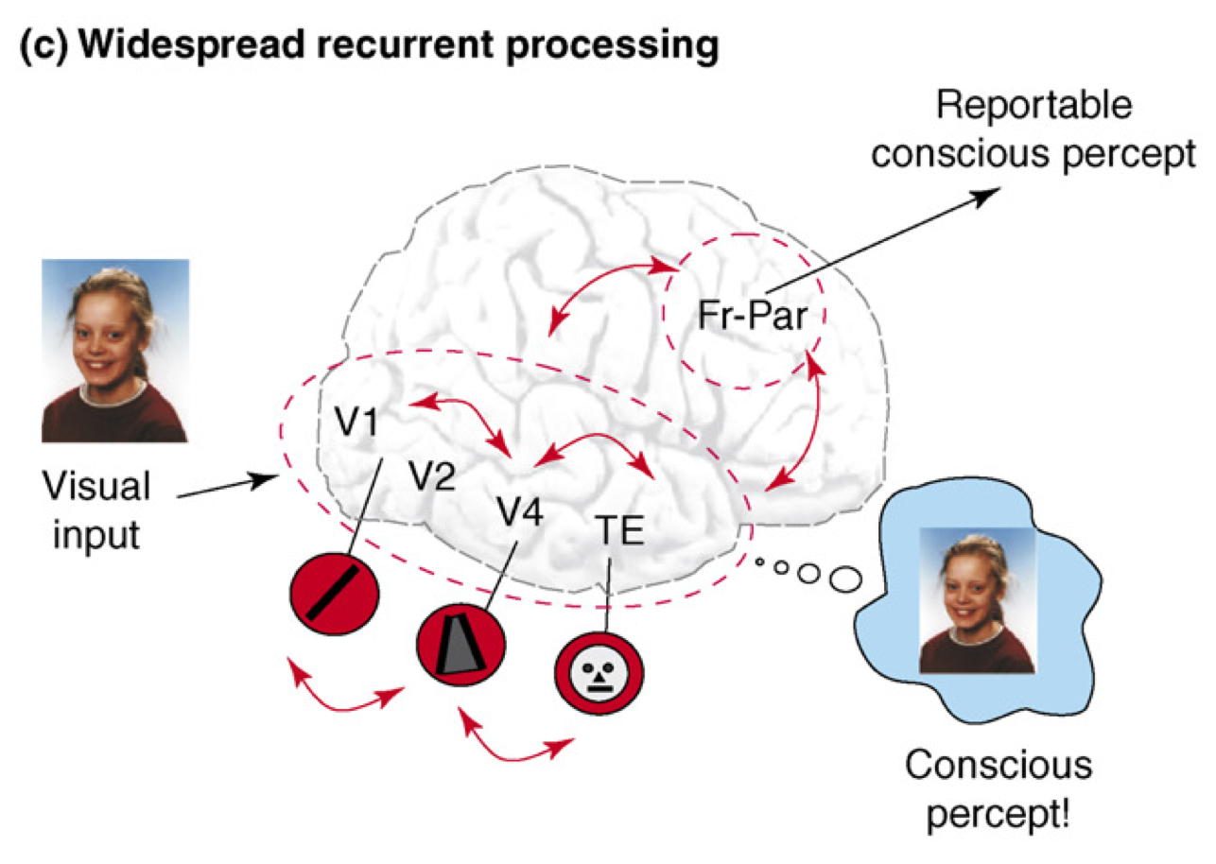
Recurrent Processing = Consciousness (Lamme, 2006)

Slide 14
Recurrence == Consciousness
Consciousness is Unitary
Recurrence coordinates all areas on one thing
(That thing emerges through popular vote)
Consciousness is Functional
We learn more about conscious things
It helps us organize, prioritize our behavior
“Focusing” is necessary for difficult problems

Slide 15
Interim Summary
Emergence is interaction
Bidirectional interactions are special
Emergent global constraint satisfaction from local updates (Hopfield)
Coordination of top-down and bottom-up
Consciousness itself!?

Slide 16
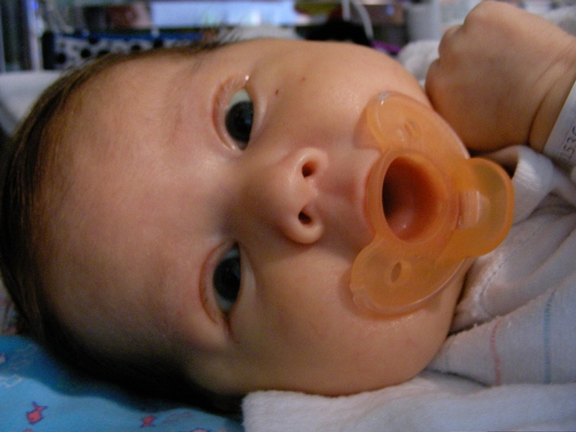
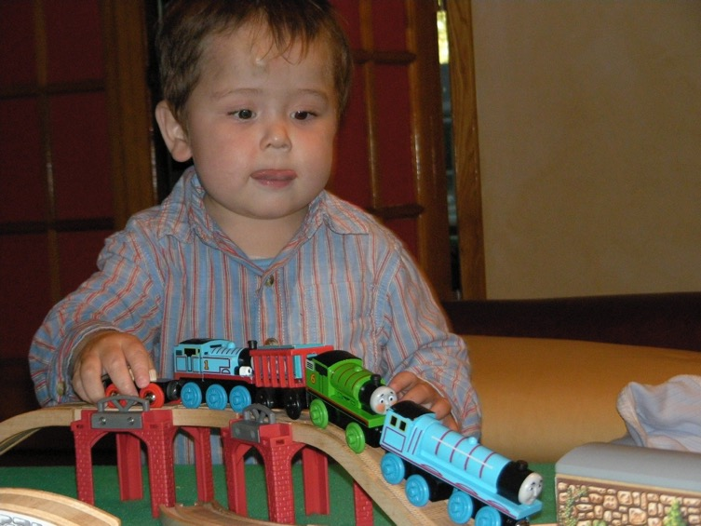
The Mystery of (Knowledge) Development
The first ~6 months: passive, but intent, staring at the world moving by..
And yet, so much is learned: the foundation for everything we know..
How does this happen!?

Slide 17
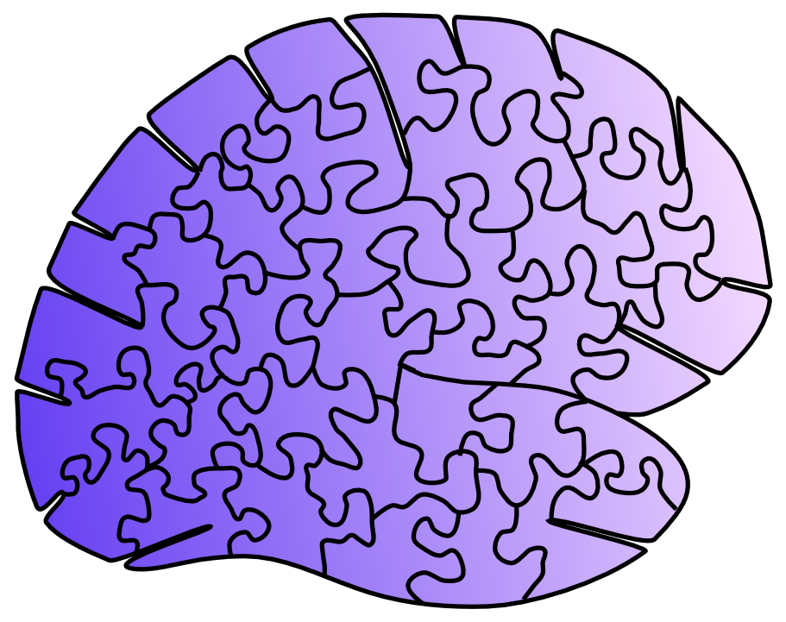
Emergence through Learning
Most of human intelligence emerges through learning, in the neocortex
No widespread agreement about nature of this process!

Slide 18
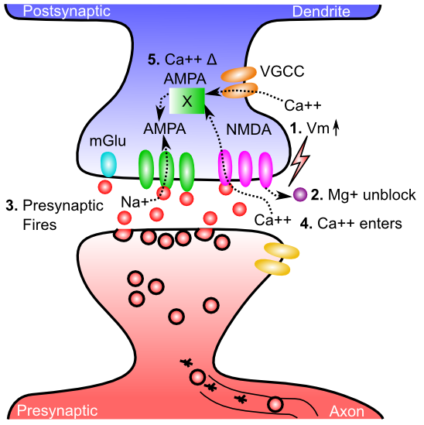
Biology is Well Understood = Hebbian Learning: Pre + Post active together

Slide 19
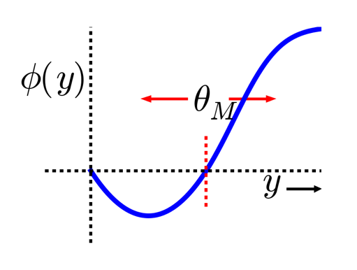
Hebbian BCM Model
Bienenstock, Cooper & Munro (1982) – BCM
(Cooper = BCS Cooper pairs)
adaptive threshold Θ
Lower when less active
Higher when more..
(homeostatic)
Too bad it doesn’t work!
(too local, not enough global)

Slide 20
Std Deep Nets:
use big labeled datasets

Slide 21
Std Deep Nets:
use big labeled datasets
Not biological: error backpropagation
What labels would you use for space, navigation??

Slide 22
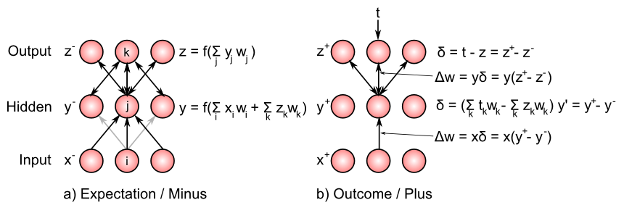
Bidirectional Connections Carry Error Gradients (GeneRec; O’Reilly, 1996)
dW = x⁺y⁺ - x⁻y⁻
(Midpoint integration + symmetry = Contrastive Hebbian = DBM)

Slide 23
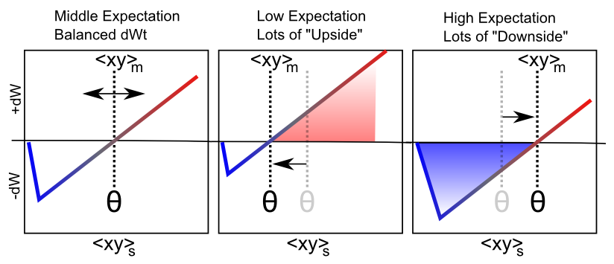
Floating Threshold = Medium Term Synaptic Activity (Error-Driven)
dW = Outcome – Expectation = <xy>_{s} - <xy>_{m}

Slide 24
Key idea: We learn by constantly generating hypotheses or predictions about what will happen next!

Slide 25
Biologically, how does it work?

Slide 26
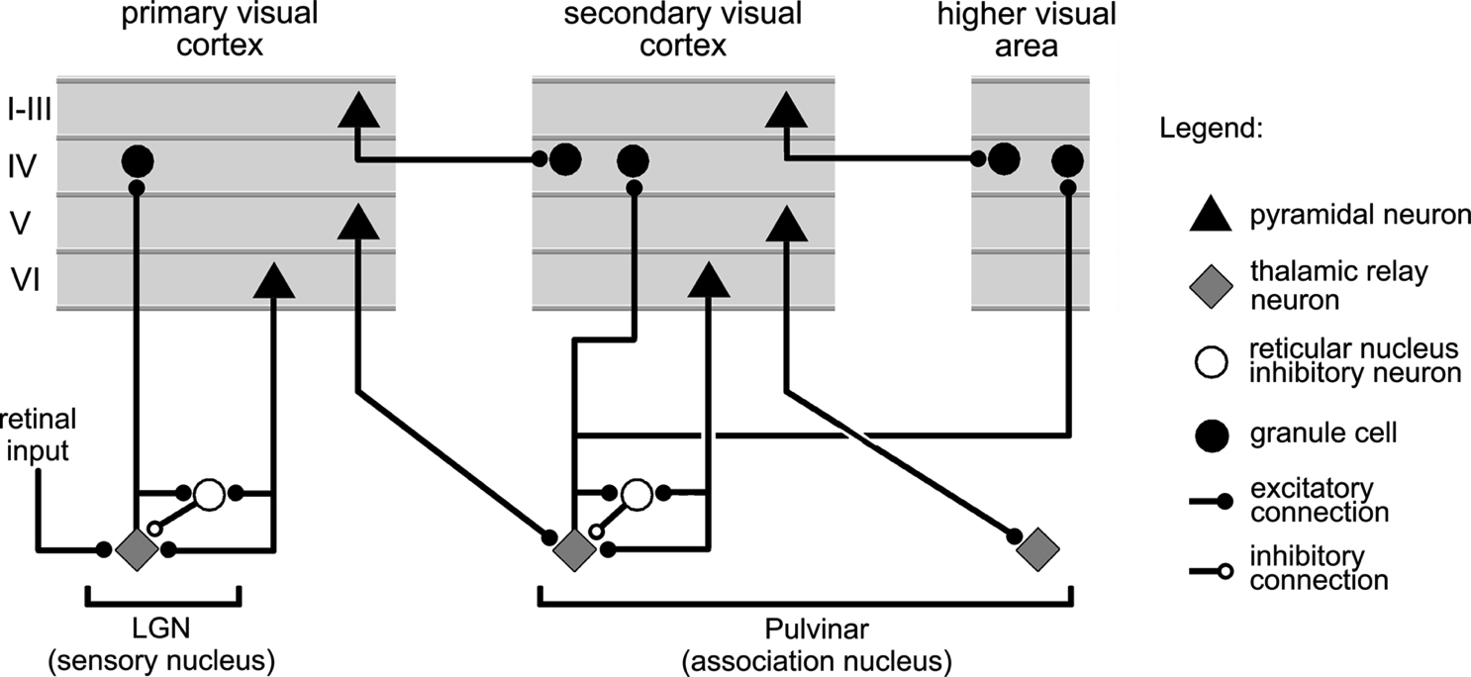
Thalamocortical Loop Biology (Sherman & Guillery, 2006)
5IB
FF
Driver
Weak
FB
“What happens”
Prediction

Slide 27
The Pulvinar = Projection Screen (c.f. Mumford, 1991 “blackboard”)
Pulvinar receives connections from all over visual cortex
and projects back out to these same areas
Two inputs:
1. Few strong feedforward:
“what happens”
2. Many weaker feedback:
prediction
Pulvinar!

Slide 28
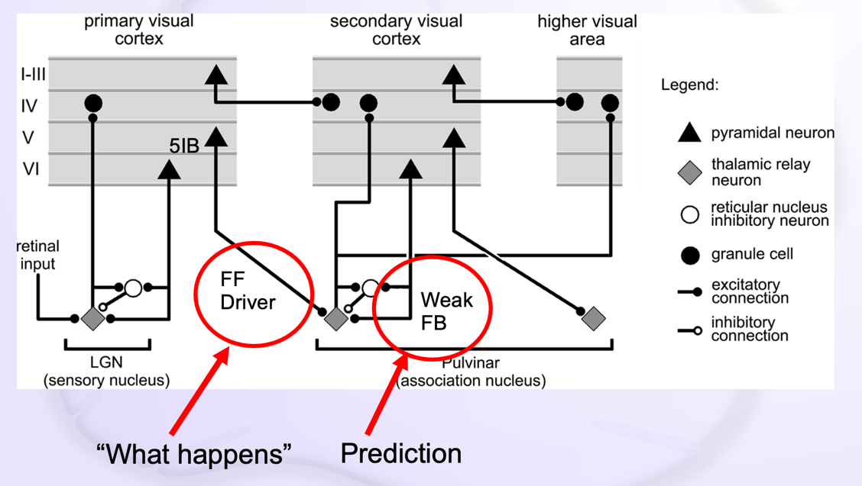
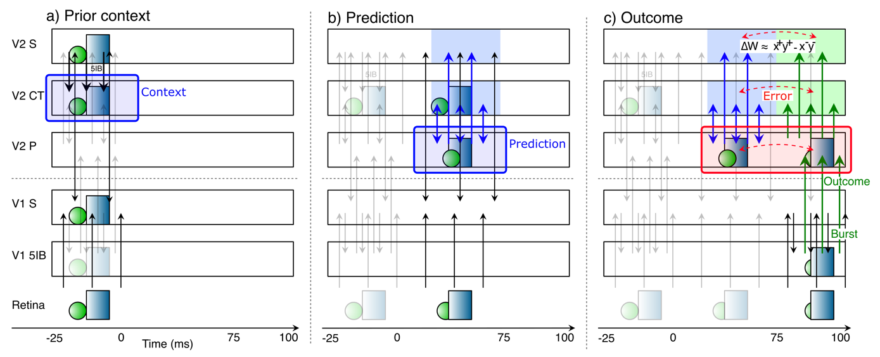
Deep Predictive Learning

Slide 29
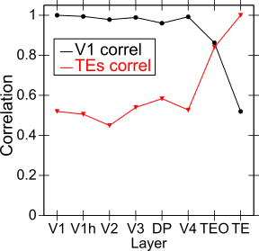
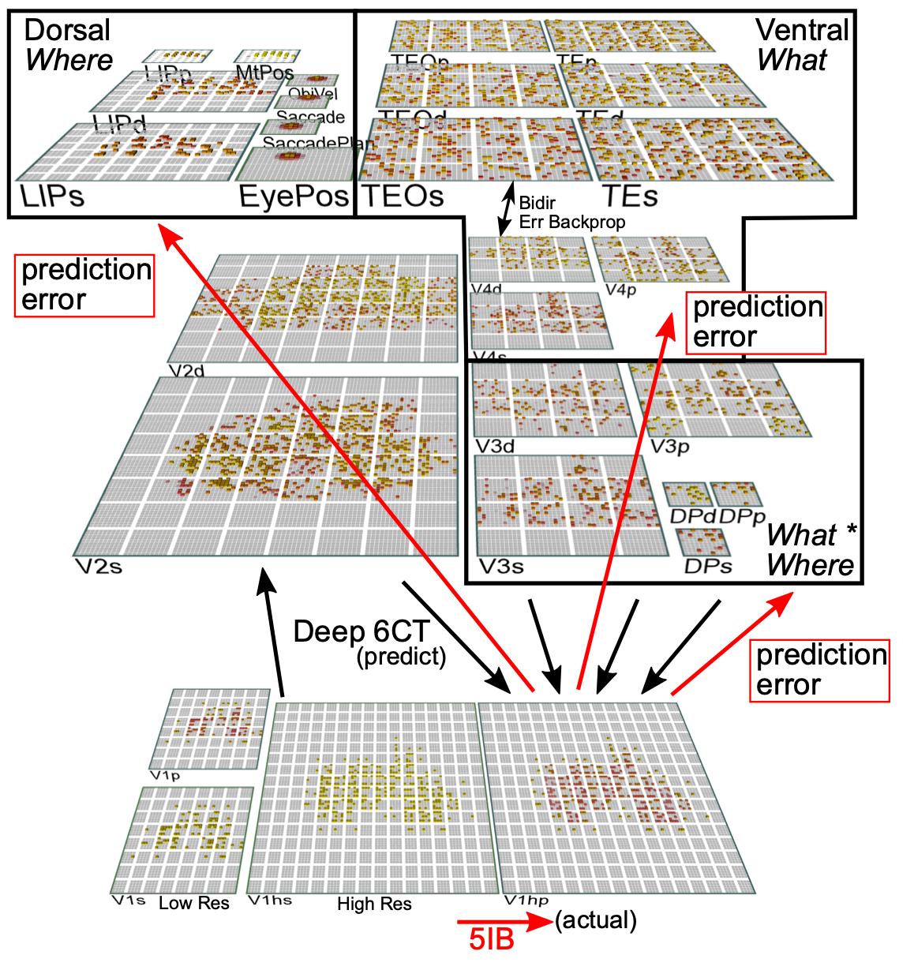
Categories not in V1; Emerge in IT Obj Rec Pathway

Slide 30
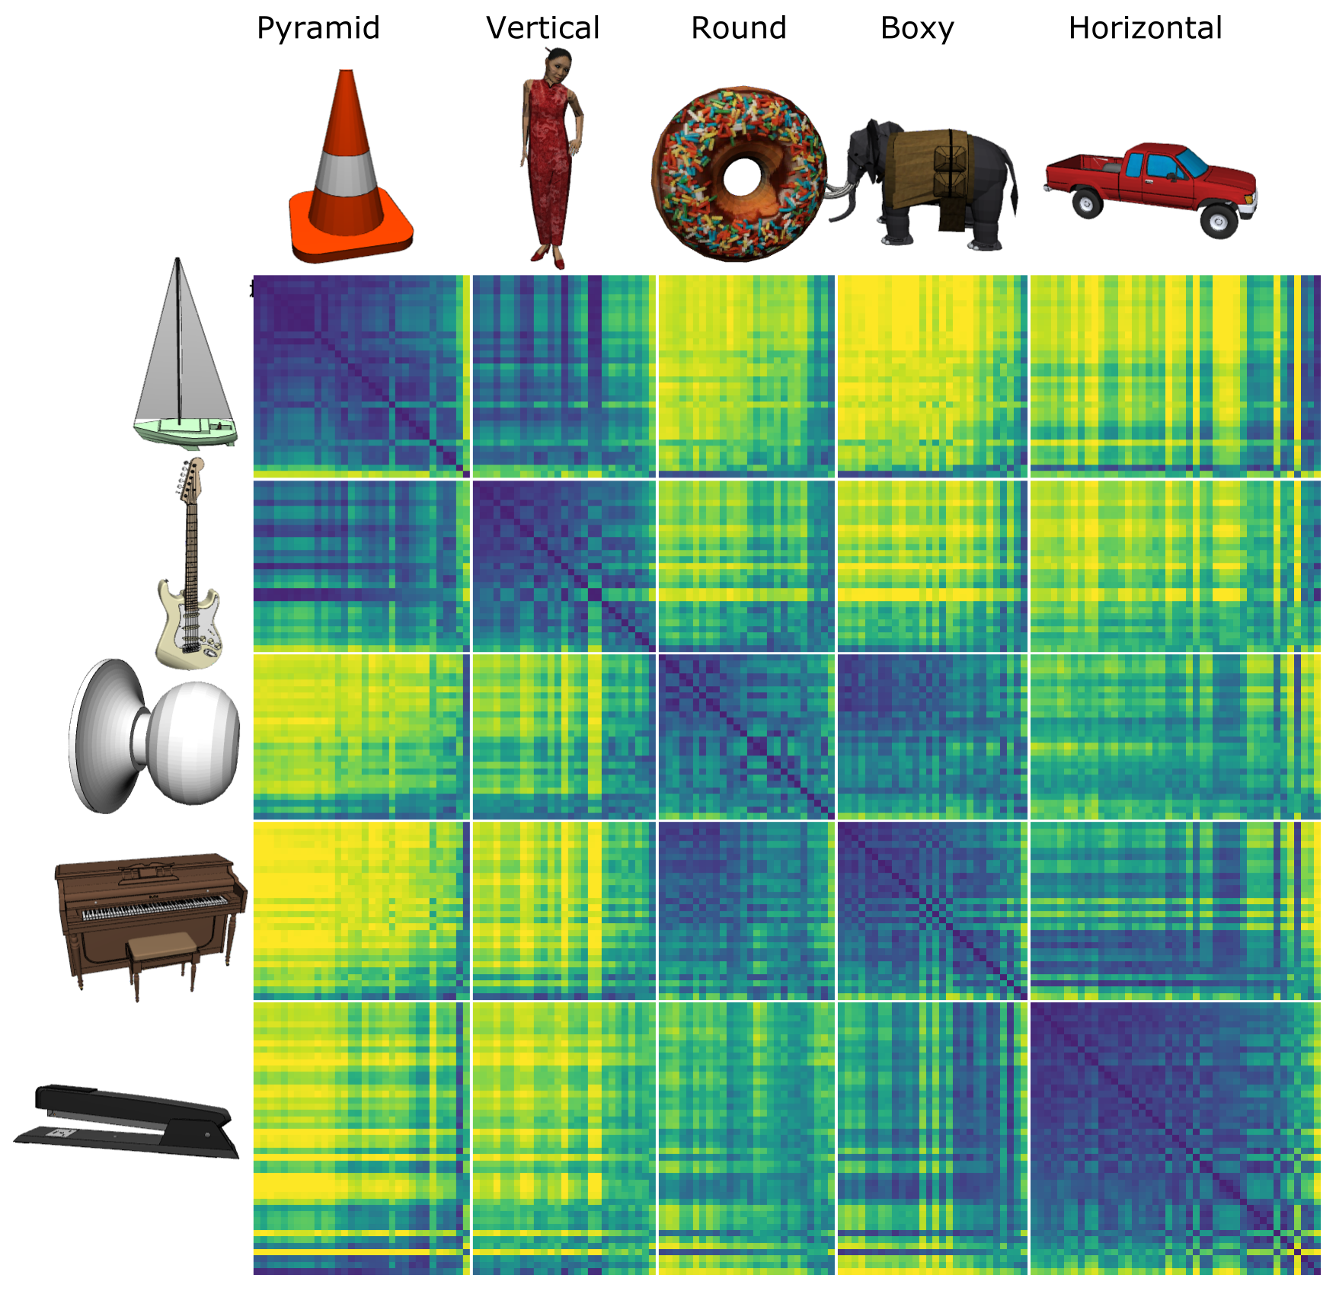
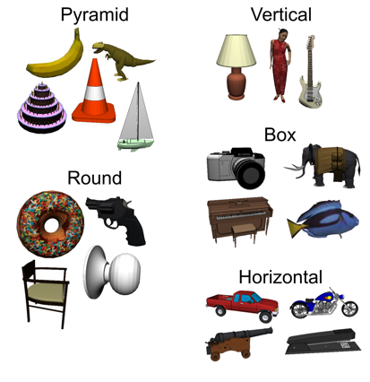
Model discovered
Shape categories!

Slide 31
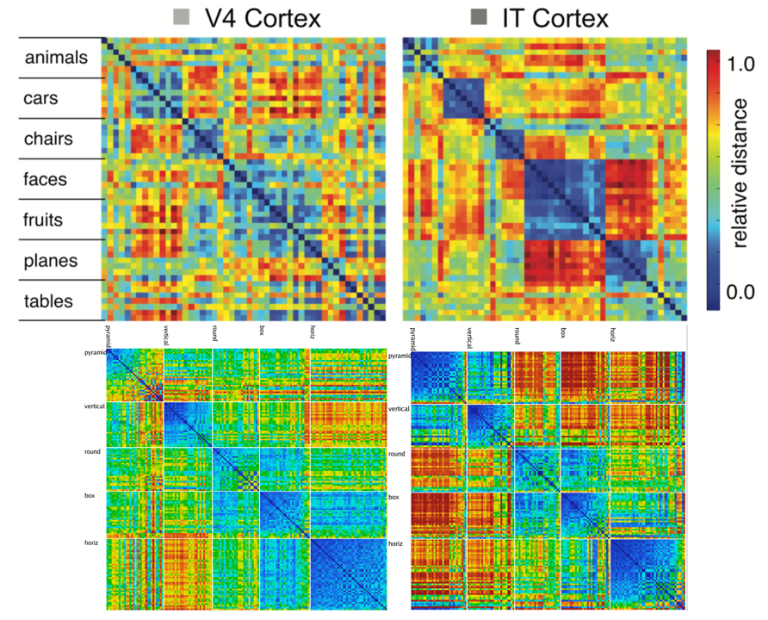
Model vs. Monkeys: Categories Emerge in Higher Layers

Slide 32

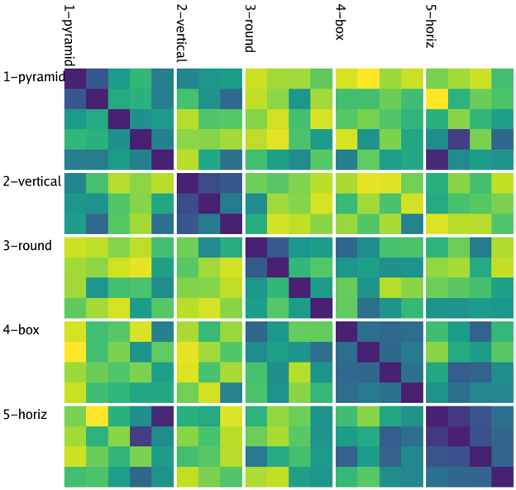
Model
People

Slide 33
Summary
Bidirectional connectivity also good for error-driven learning in neocortex
Thalamus <-> cortex drives predictive learning
Models show that abstract categories emerge
Consistent with synaptic mechanisms
New data confirms temporal error signal

Slide 34
Thanks To
CCN Lab
Andrew Carlson
Riley DeHaan
Tom Hazy
Seth Herd
Kai Krueger
April Luo
Jessica Mollick
Ananta Nair
John Rohrlich
Jake Russin
Maryam Zolfaghar
Funding
ONR – Hawkins & McKenna
Collaborators
Charan Ranganath (Davis)
Erie Boorman (Davis)
Ignacio Saez (Davis)
Jonathan Cohen (Princeton)

Slide 35
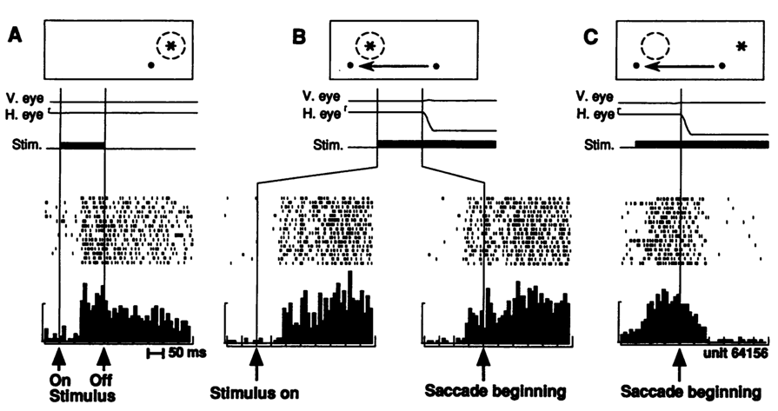
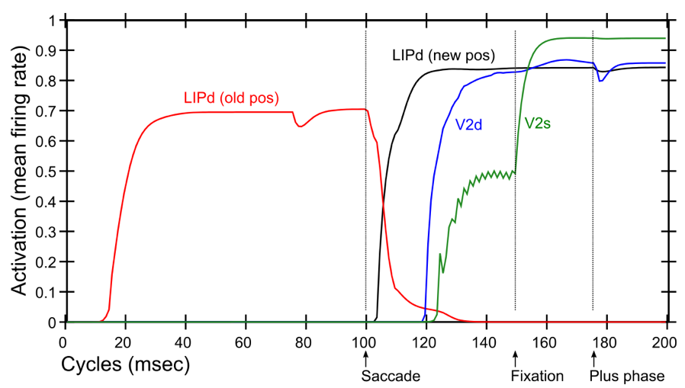
Predictive Remapping
Duhamel et al. (1992):
LIP neurons anticipate effect of saccade, start firing for new location before fixation lands (even before saccade)
Model:
LIPd remaps first at high, abstract level, drives top-down remapping in lower areas – consistent with Cavanagh et al. (2010)

Slide 36
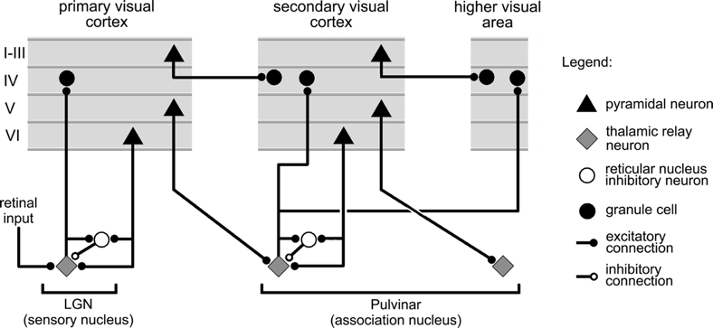
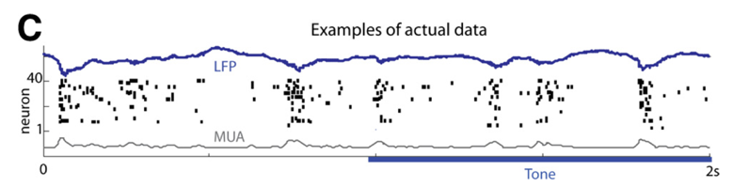
Key Biological Data
Strong, synchronized, low-frequency modulation of cortex (at the alpha frequency).
Specificity of alpha modulation to deep layers & thalamus, not superficial layers.
Nature of deep-layer connectivity to pulvinar: numerous, weaker, plastic pathway (for generating a prediction) and sparse, strong, fixed pathway (for ground truth target).
Synchronization of this strong pathway input with the alpha cycle.
Broad connectivity of pulvinar with different visual pathways (afferent and efferent).
Lack of direct bottom-up superficial projections into the deep layers (would short-circuit prediction), but presence of these projections top-down (beneficial).
Bidirectional (top-down and bottom-up) connectivity between superficial layers.
Early development of the Where (MT, LIP) pathway.
Organization into three separable (yet highly interconnected) visual pathways, particularly a third putative What*Where integration pathway.
(Buffalo et al., 2011; van Kerkoerle et al., 2014; Shipp, 2003; VanRullen & Koch, 2003; Luczak et al., 2013..)

Slide 37
“Standard” approach (Friston et al)
Explicit error-coding neurons subtracting top-down vs. bottom up
But: no evidence of such cells!

Slide 38
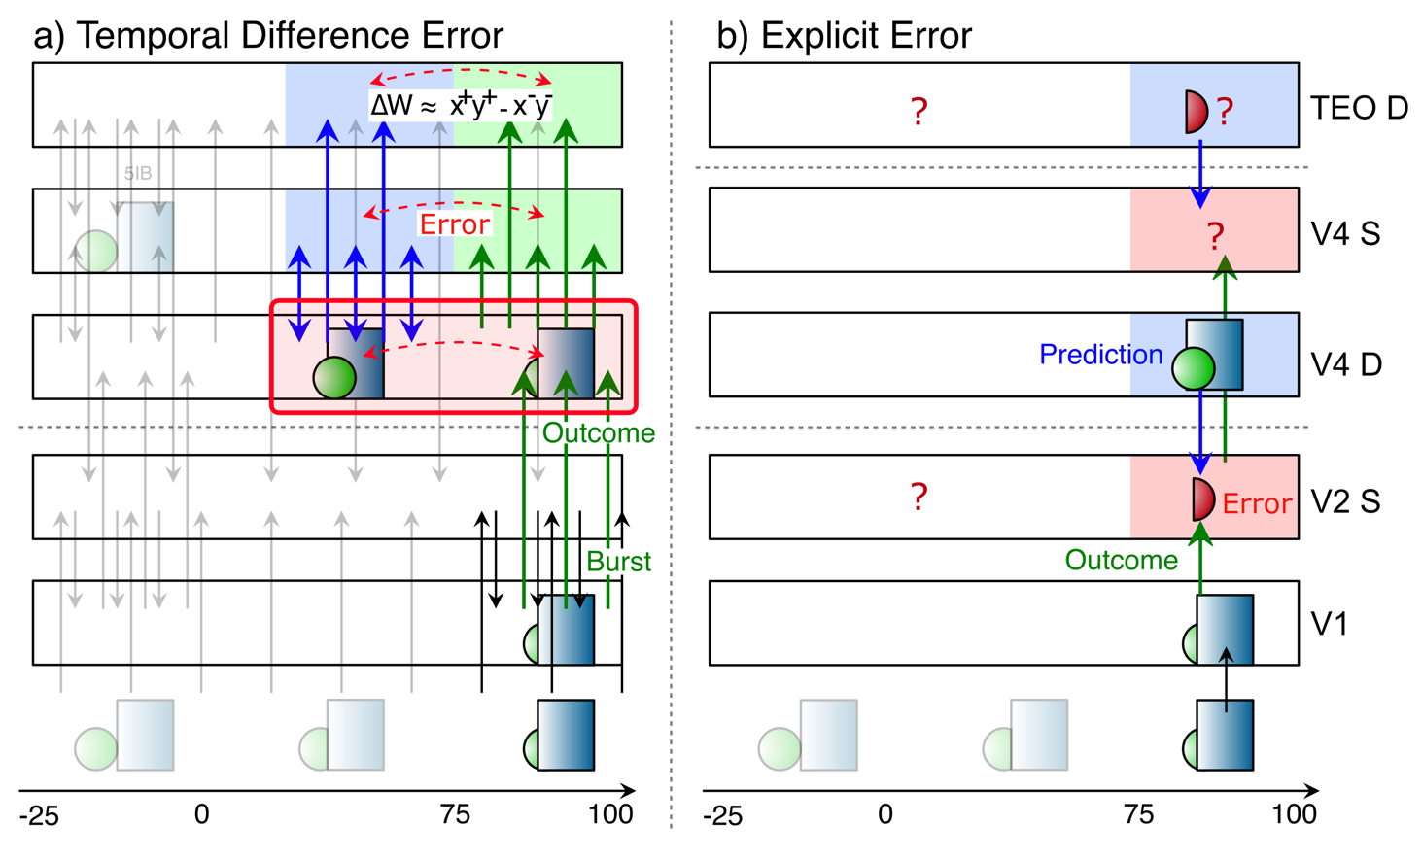
Key Diffs From Friston / Bayes

Slide 39
Floating Threshold = Medium Term Synaptic Activity (Error-Driven)
dW = Outcome – Expectation = <xy>_{s} - <xy>_{m}

Slide 40
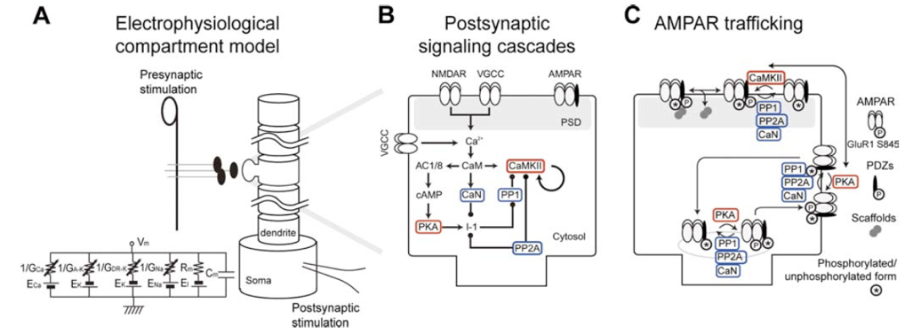
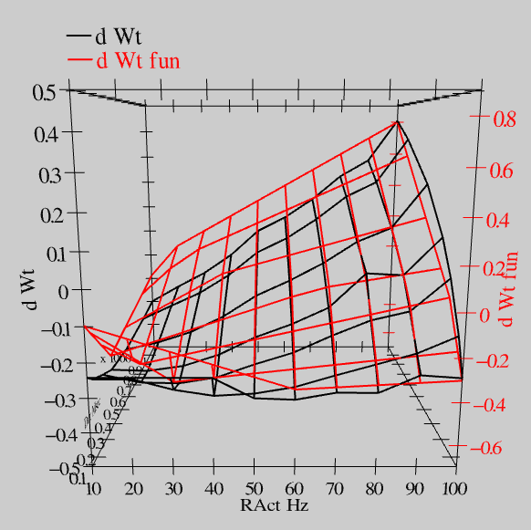
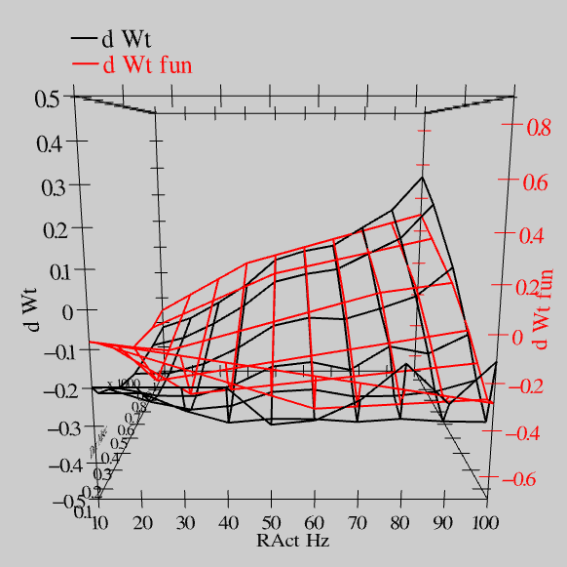
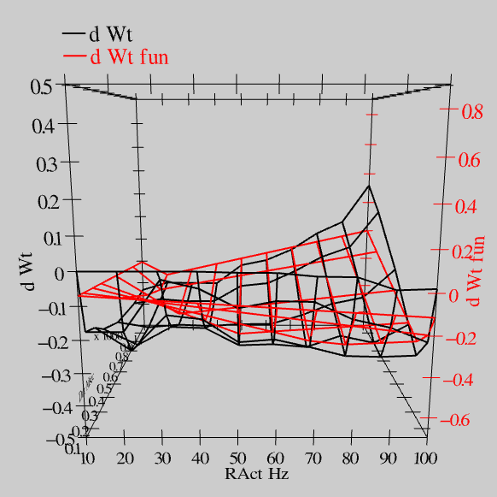
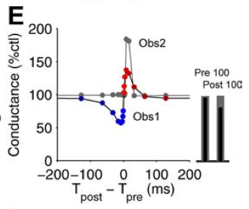
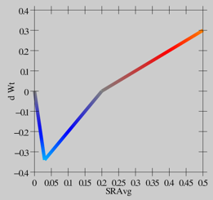
Synaptic Plasticity: XCAL Model (reduction of Urakubo et al, 2008 STDP model)
S = 100Hz
S = 50Hz
S = 20Hz
dW = f(send * recv) =
(spike rate * duration)
r=.894

